Slide 1
ELECTROCHEMISTRY
LECTURE- 01

Slide 2
What is electrochemistry?
Electrochemistry is the science that unites electricity and chemistry. It is the study of the transfer of electrons. If a chemical reaction is driven by an external applied voltage, as in electrolysis, or if a voltage is created by a chemical reaction, as in a battery, it is an electrochemical reaction.

Slide 3
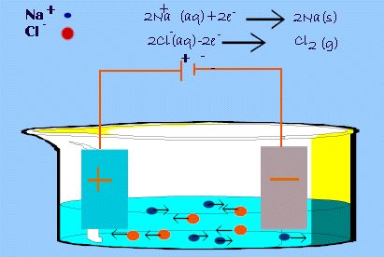

Slide 4
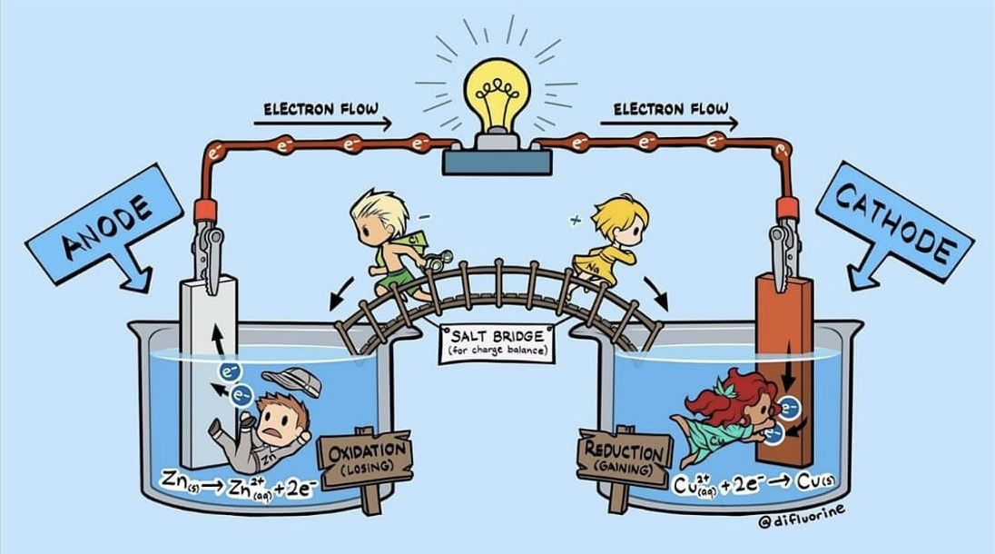
Convention in Electrochemistry

Slide 5
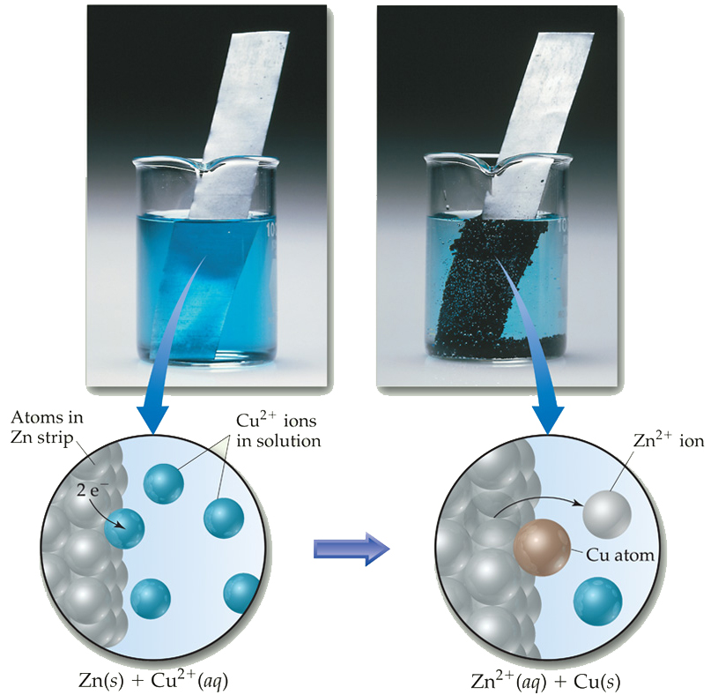
Direct Electron Transfer
In (redox) reactions, electrons are transferred and energy is released.
Cu gains e- and Zn loses e-
This type of transfer doesn’t allow for any useful work to be done by the electrons.

Slide 6
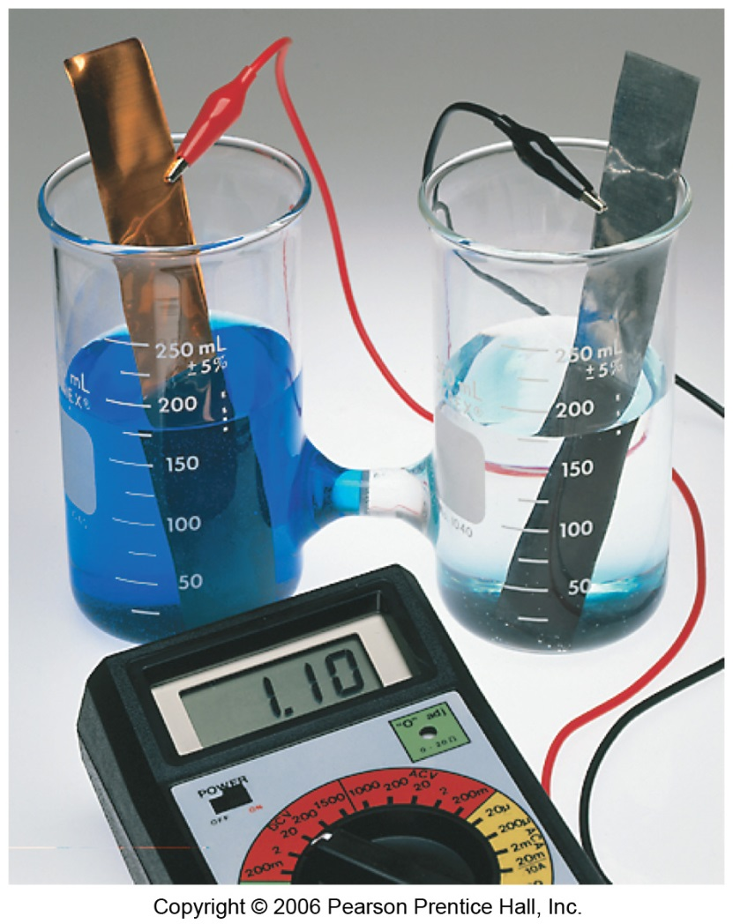
We can use the energy from the transfer of electrons to do work if we make the electrons flow through an external device.
It provides power to do work.
We call such a setup :
  Voltaic cell
  Battery
  Electrochemical cell
  Galvanic cell

Slide 7
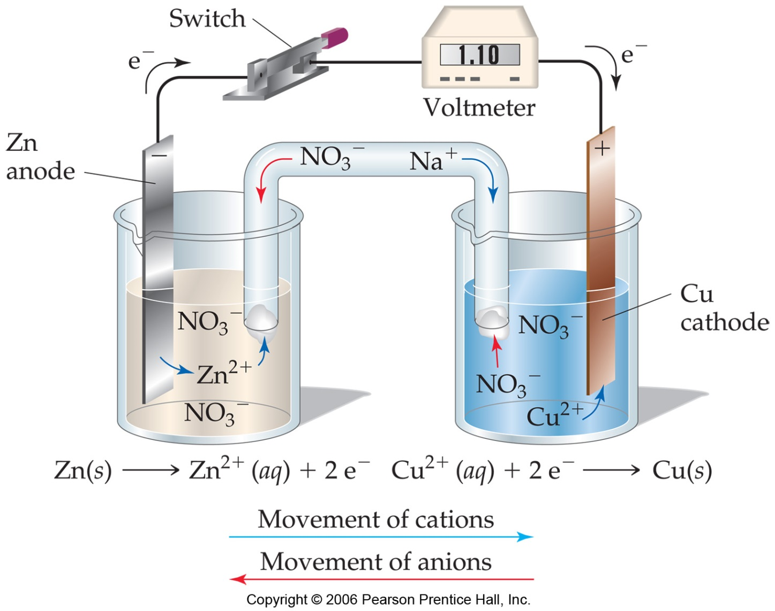
Typical Voltaic Cells
The oxidation occurs at the ANODE.
The reduction occurs at the CATHODE.
Electrons flow through the wire!

Slide 8
What is voltaic cell?
Voltaic cell is an electrochemical cell that makes use of chemical reactions to generate electrical energy.

Slide 9
Volt meter: measures the electric current. In galvanic cells, this shows how much voltage is produced and in electrolytic cells, this shows how much voltage is applied to the system.
Electrolyte:
  conducting medium.
  has contact with electrodes
  usually in aqueous solution of ionic compounds.
Salt Bridge:
  joins the two halves of the electrochemical cell.
  filled with a salt solution or gel.
  keeps the solution separate.
  Completes the circuit.

Slide 10
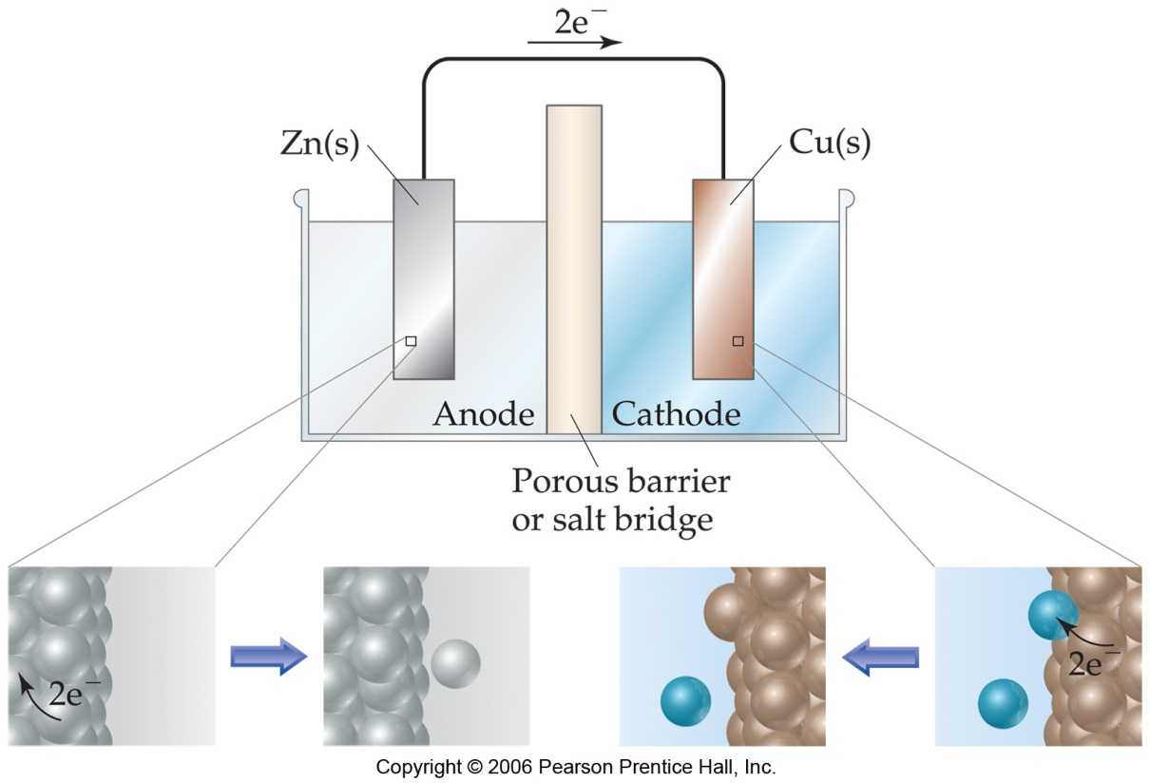
In the cell, electrons leave the anode and flow through the wire to the cathode.
As the electrons leave the anode, the cations formed dissolve into the solution in the anode compartment.
The ANODE will DECREASE IN SIZE

Slide 11
As the electrons reach the cathode, cations in the cathode compartment are attracted to the now negative cathode.
The metal is deposited on the cathode.
THE CATHODE WILL INCREASE IN SIZE.

Slide 12
THANK YOU!

